Slide 1
Writing Papers in the Biological Sciences
An introduction to Biological research and paper writing

Slide 2
Chapter ten
Research talk and Presentation

Slide 3
Purpose of a research talk
Is not to:
Impress the audience
Tell them all you know about a subject
Present every little detail of your work
Is to:
Give the audience a sense of what your idea/work is
Make them want to read your paper
Get feedback on your work

Slide 4
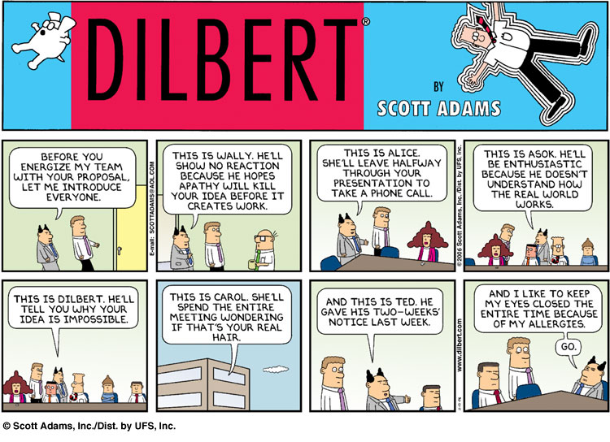
Know your audience

Slide 5
Know your audience
Who would be there?
  Scientists expert in your field
  Scientists not expert in your field
  Students
  Non experts
Most likely a mix so have something for all!!.

Slide 6
Know your audience
Keep in mind:
  They might be tired
  They can read ☺
  They are thinking “Why should I listen?”
  Non-experts will tune off within 2 minutes
  Experts after 5 minutes
What can you do?!!!

Slide 7
What can you do?
Early motivation - at the beginning of your talk motivate your research with easy to understand examples.
Spoil the punch line - State your results early and in simple terms.
Visuals – Illustrate your idea with images and diagrams.

Slide 8
Leave them with these thoughts
I understood what the problem was and why it was important.
I have an idea of what his/her solution was and how it was different/better than others
He/She knows the literature (i.e. quoted my work ☺) and we might collaborate on this aspect of this research.

Slide 9
Use examples
Examples are your weapon to:
  Motivate your work
  Illustrate the basic awareness/intuition
  Show your solution in action.
  Highlight extreme cases or shortcomings
If you are running out of time cut the general case not the example

Slide 10
Where were you?
People will get lost during your talk!!. even those who are listening.
  have a running outline of the main steps of your idea (more than the talk itself).
  use visual clue to highlight where you are in the process.
  present it at the beginning of each step.

Slide 11
Related work
Be familiar with all related work
Don’t list each paper you read
Mainly talk about results that are immediately related to what you did
References at the end of the talk .
Acknowledge co-authors (title slide/last slide)

Slide 12
Technical details: in or out?
A fine line:
  Present specific aspect that show the “meat” of your work
  Leave the rest out….. If you were convincing they will read your paper
  Don’t fill up your slides with lots of equations
  Prepare back-up slides to answer questions…..Leave them at the end of the presentation

Slide 13
The skeleton
What is the problem…
Motivation and goals…
Relevant state of the art…
What is your key idea/contribution….
Why is your approach good/better….
What I just said and what I want to do next…

Slide 14
Preparing the presentation
Fill in with narration not words
Use animation sparingly
Use color to emphasize some points but limit to 2 or 3
Be consistent! In the choice and use of color font size/type…etc
Use slide real estate appropriately

Slide 15
Slide layout – Bad - ☹
This page contains too many words for a presentation slide. It is not written in point form, making it difficult both for your audience to read and for you to present each point. Although there are exactly the same number of points on this slide as the previous slide, it looks much more complicated. In short, your audience will spend too much time trying to read this paragraph instead of listening to you.

Slide 16
Slide layout – Good - ☺
Show one point at a time:
  Will help audience concentrate on what you are saying
  Will prevent audience from reading ahead
  Will help you keep your presentation focused

Slide 17
Fonts – Good ☺
Use a decent font size
Use different size fonts for main points and secondary points
  this font is 28-point, the main point font is 32-point, and the title font is 40-point
Use a standard font like Times New Roman or Arial

Slide 18
Fonts – Bad ☹
If you use a small font, your audience won’t be able to read what you have written
CAPITALIZE ONLY WHEN NECESSARY. IT IS DIFFICULT TO READ
Don’t use a complicated font

Slide 19
Color – Good ☺
Use font color that contrasts sharply with the background
    Blue font on white background
Use color to reinforce the logic of your structure
    Ex: light blue title and dark blue text
Use color to emphasize a point
    But only use this occasionally

Slide 20
Color - Bad ☹
Using a font color that does not contrast with the background color is hard to read
Using color for decoration is distracting and annoying.
Using a different color for each point is unnecessary
    Same for secondary points
Trying to be creative can also be bad

Slide 21
Background – Good ☺
Use backgrounds such as this one that are attractive but simple
Use backgrounds which are light
Use the same background consistently throughout your presentation

Slide 22

Background – Bad
Avoid backgrounds that are distracting or difficult to read from
Always be consistent with the background that you use
☹

Slide 23
Graphs – Good ☺
Use graphs rather than just charts and words:
  Data in graphs is easier to comprehend & retain than is raw data.
  Trends are easier to visualize in graph form.
Always title your graphs

Slide 24
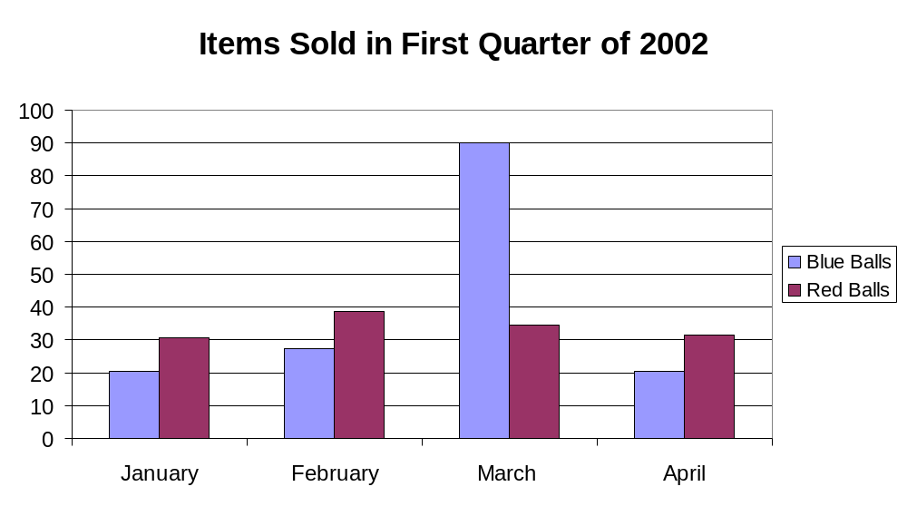
Graphs - Good ☺

Slide 25
Graphs - Bad
Minor gridlines are unnecessary
Font is too small
Colors are illogical
Title is missing
Shading is distracting

Slide 26
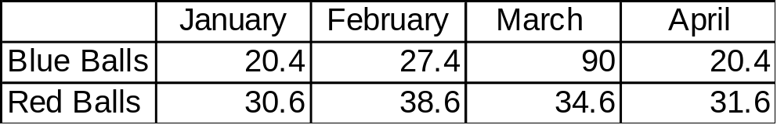
Graphs - Bad
☹

Slide 27
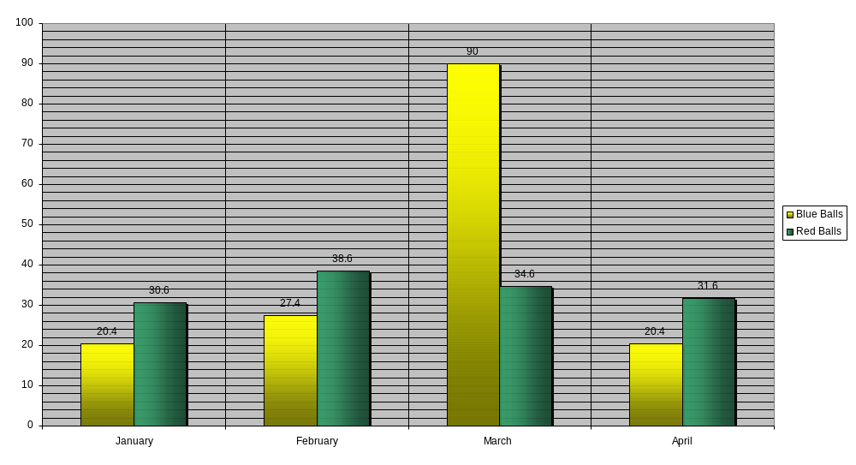
Graphs – Bad ☹

Slide 28
Preparing the presentation
Prepare the slides in advance
Show them to friends
When you think you are done read them again
Check all animations with the sound on (if there is any).

Slide 29
Preparing the presentation
Practice, practice, practice….
  Give a practice talk to a general audience
  Give a practice talk to an audience of expert
  Time your presentation (allow for speed up effect caused by nervousness)
Always assume technology will fail you. Have backups.

Slide 30
Delivering the talk
Be enthusiastic! If you aren’t why should the audience be?
Make eye contact with the audience
Watch for questions. Be prepare to digress or brush off when irrelevant..

Slide 31
Delivering the talk
Point at the screen not the computer
Do not read directly from the PPT or your notes
Have the “spill” for the first couple of slides memorized in case you go blank
Finish in time!!!

Slide 32
Handling questions
Different types – handle accordingly
  Need clarification
  Suggest something helpful
  Want to engage in research dialog
  Show that he/she is better than you
Anticipate questions (additional slides)

Slide 33
How can I get better?
Practice every chance you can
Observe others
  Steal good presentation ideas
  Notice all the things that turned you off
Seek comments from friends and mentors/adviser

